Slide 1
Two Decades of Dengue Outbreaks in Bangladesh (2000-2022): Climate Change, Environmental Niche, and Future Control Planning
Dr. Najmul Haider
Lecturer in Epidemiology
Keele University, the UK
11th One Health Conference
Dhaka, Bangladesh
Email: n.haider@keele.ac.uk

Slide 2
Dengue virus in Bangladesh
2000-2010
2011-2022

Slide 3

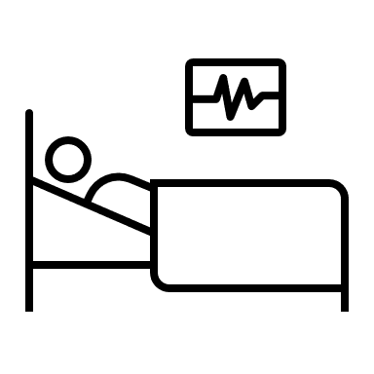
Two decades of dengue infection
Cases: 8 times
First decade
(2000-2010)
Annual dengue cases: 2,216
Annual dengue deaths: 4.75
Recent decade
(2011-2022)
Annual dengue cases: 18,321
Annual dengue deaths: 45.83
Deaths : 10 times

Slide 4



Two decades of weathers
Temp: 0.30 °C
2628 degree-hours/yr
First decade
(2000-2010)
Annual temperature : 26.5
Annual rainfall (mm) : 2161
Outside Monsoon rainfall (mm):
Recent decade
(2011-2022)
Annual temperature: 26.8
Annual rainfall : 1765
Outside Monsoon rainfall (mm):
Rainfall: 399
(mm)
Outside Monsoon Rain increased XX times

Slide 5
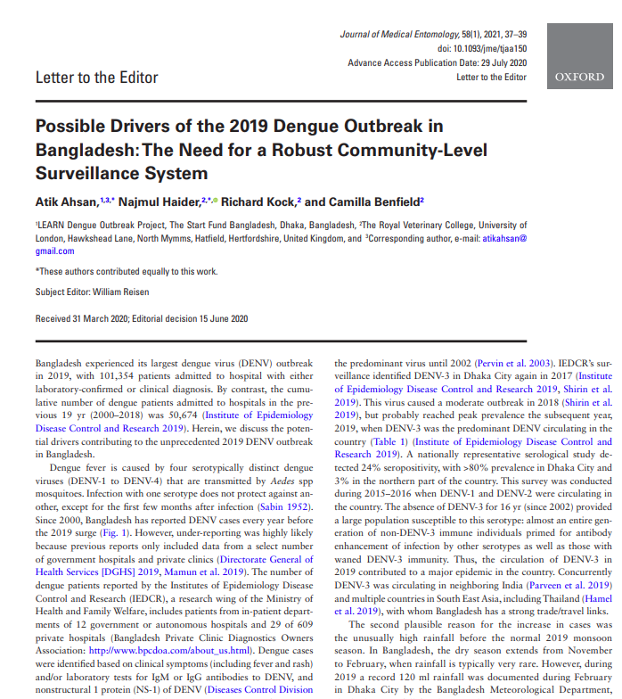
2019 Outbreak: highest cases
New serotype DENV-3
Early rainfall
Insecticide resistant

Slide 6
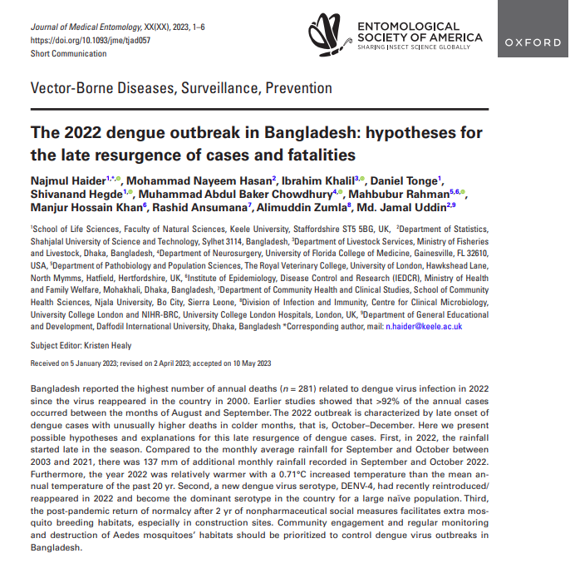
2022 Outbreak: highest deaths
New serotype DENV-4
Late rainfall
Returning to normalcy after the pandemic

Slide 7
Monthly growth factor

Slide 8
Virus development period

Slide 9
How frequently does a mosquito bite?

Slide 10
Trends of dengue cases

Slide 11
Climatic variables
 | IRR (95% CI) | P-value
Average temperature | 1.26 (1.258 – 1.265) | <0.001
Rainfall (lag 1) in centimeter | 1.08 (1.079 – 1.086) | <0.001
Rainfall (lag 2) in centimeter | 1.17 (1.168 – 1.175)) | <0.001

Slide 12
Summary
Dengue cases increased by 8 times, deaths by 10 times
Unusual weather – global warming, early & late rain
Early control essential (April-June) – successful
No magic bullet: Regular destruction of mosquito breeding sites
Other Aedes-borne diseases: YF, Chikv, ZIKV, RVF

Slide 13
Thank you

